Slide 1
Retinal Vessel Segmentation
Jakub Svoboda – xsvobo0z

Slide 2
The task
Localize and segment blood vessels in human retinal images
Try out multiple algorithms
Measure and compare accuracy

Slide 3
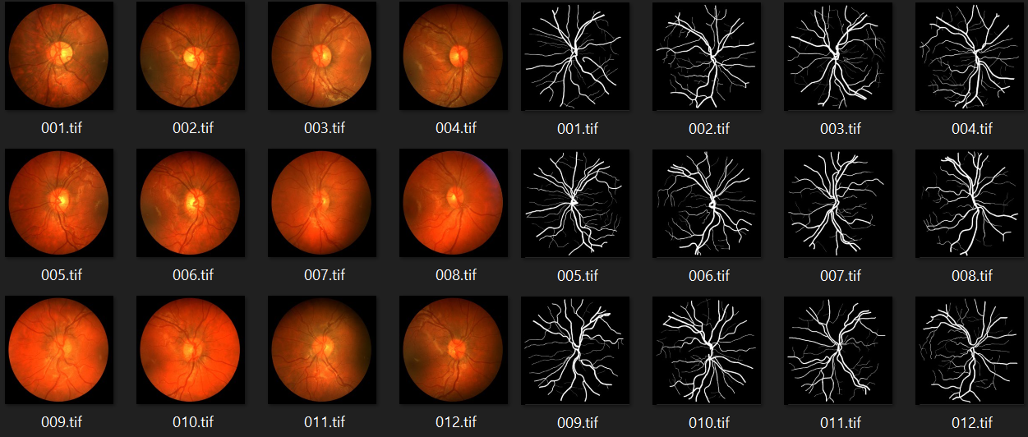
The datasets
A merge of DRIVE dataset, STARE dataset and the CHASE DB1.
20 + 28 + 20 images = 68 total (+ 68 masks)
For neural network – 48/20 train/test split

Slide 4
Methods
Binary global thresholding
Adaptive thresholding (mean and gaussian)
U-Net neural network

Slide 5
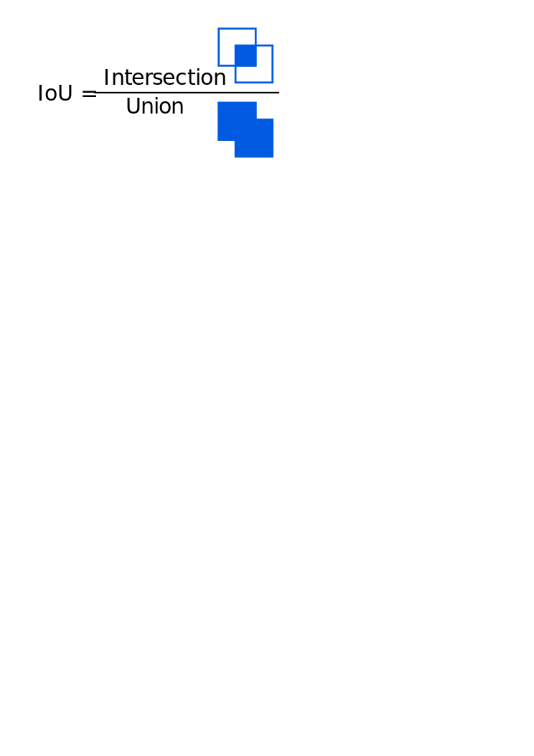
Results
Accuracy measurement: IoU
Intersection of pixels divided by the union
Method: | Accuracy
Binary global thresholding | 8%
Adaptive thresholding - mean | 23%
Adaptive thresholding - gaussian | 21%
U-Net | 38%

Slide 6
Demonstration

